Slide 1
Honeypot Security Analysis
Emerging Issues & Cyber Warfare
James Coleman
12/5/2023

Slide 2
Project Overview
Objective: The main objective of this project was understanding honeypots and their uses by using two different types of honeypots to gather unauthorized activities from attacks in network environments.
Scope: The main significance of this project is to expose us to the uses of honeypots as well as understand different types of information that a honeypot can record for us.

Slide 3




Research/planning
Tools used for this project:
Ubuntu and Kali linux
Cowrie and openCanary
Wireshark and Nmap networking tools
ELK Stack logging tools
Initial strategy: use Cowrie and openCanary to capture unauthorized activity from within our network environment.
Objectives:
Run SSH attacks on the Cowrie honeypot and capture the malicious activity
Run Password attacks on the FTP honeypot and capture the malicious activity

Slide 4
Deployment
Isolation: Used separate physical networks for both honeypots
Cowrie Honeypot: for SSH attacks, Opened port 22 and 2222, used Nmap for network tool, and implemented ELk Stash for visualization
openCanary: for password attacks, Opened port 21, used Nmap for network tools and implemented ELK Stash for visualization
Cowrie Github Repository:
https://github.com/cowrie/cowrie
OpenCanary Github Repository:
https://github.com/thinkst/opencanary

Slide 5
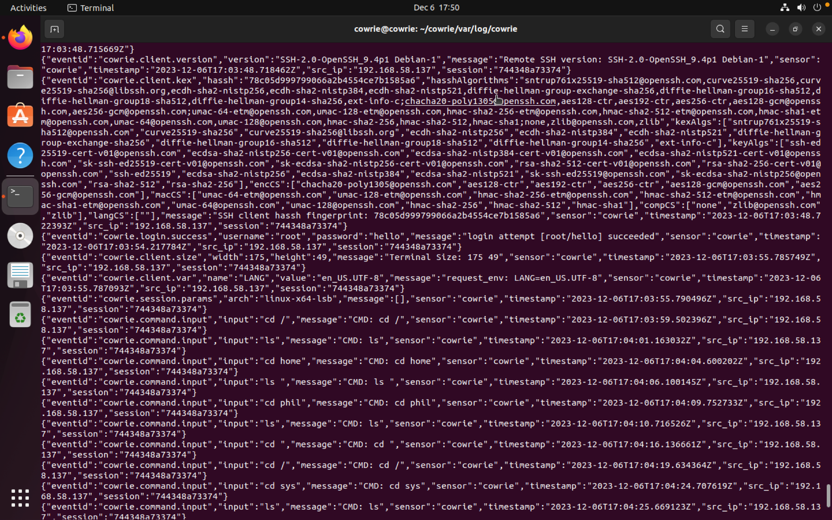
Data Collection
Cowrie JSON

Slide 6
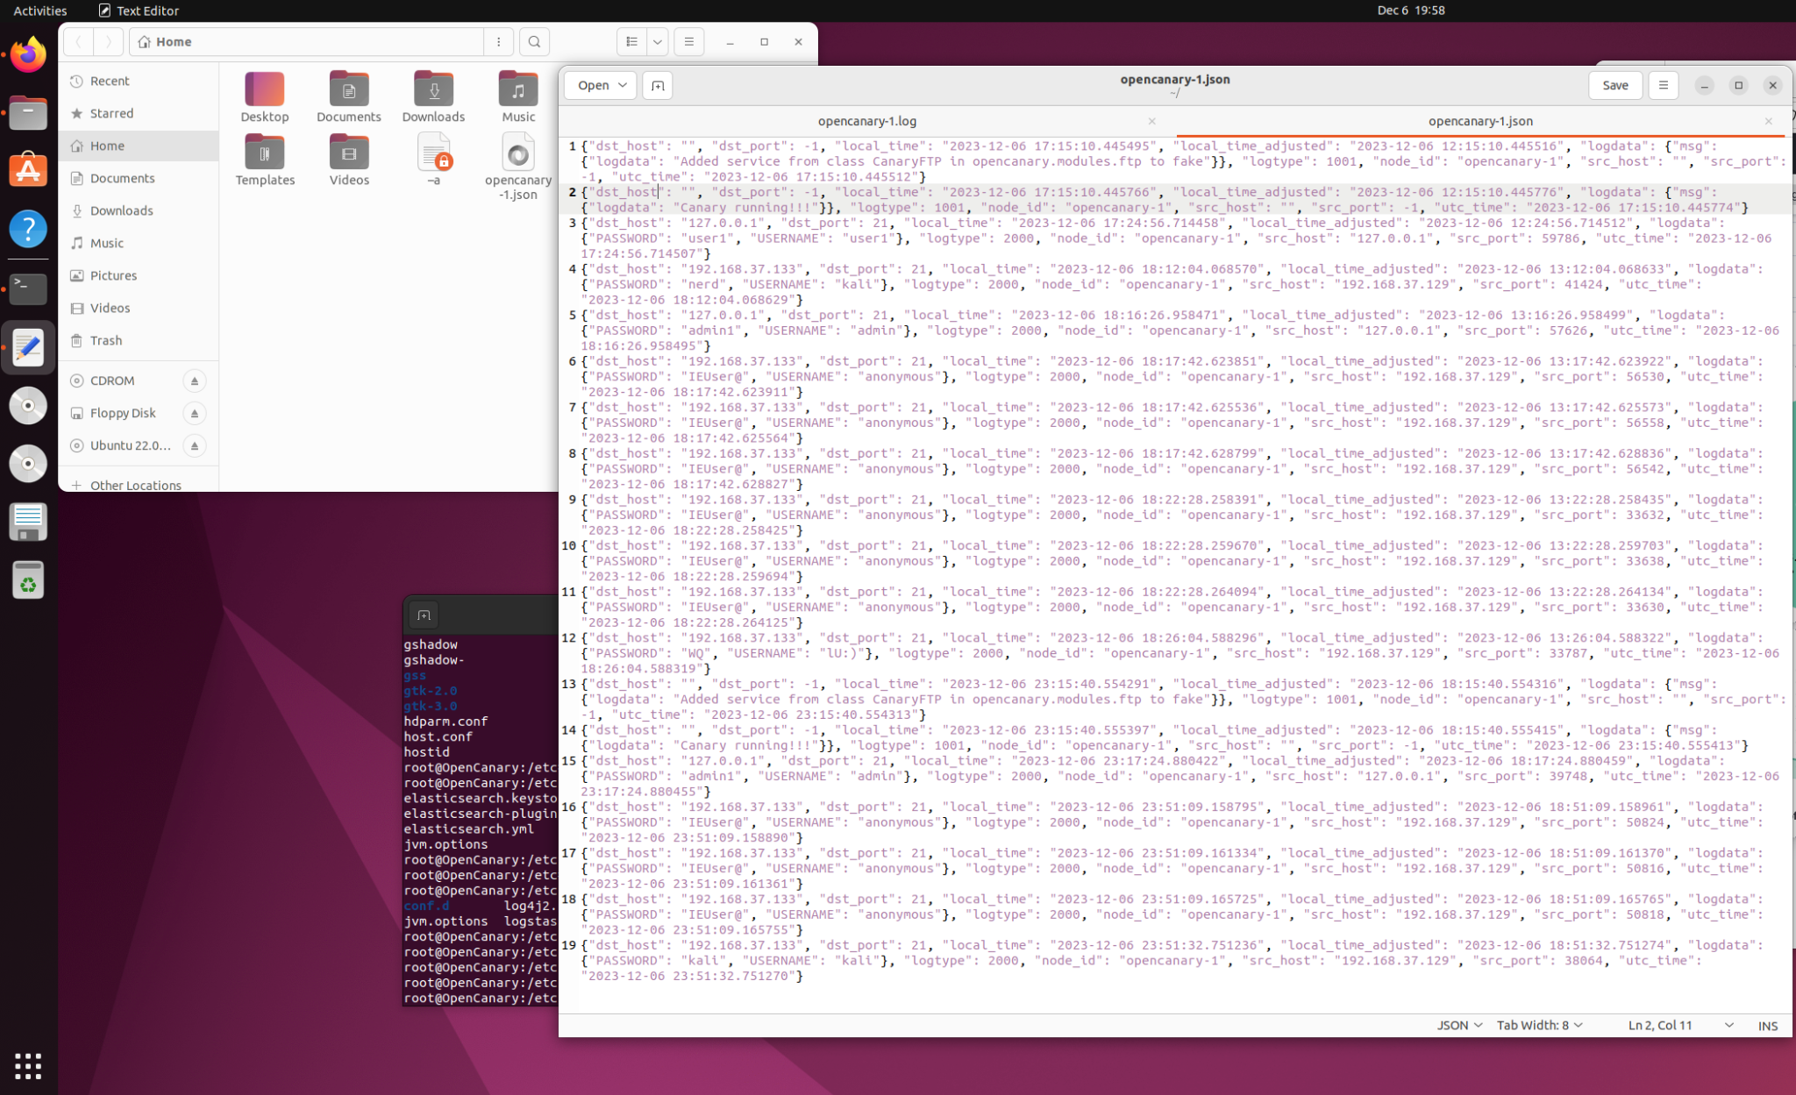
Data Collection
Part 2
openCanary JSON

Slide 7
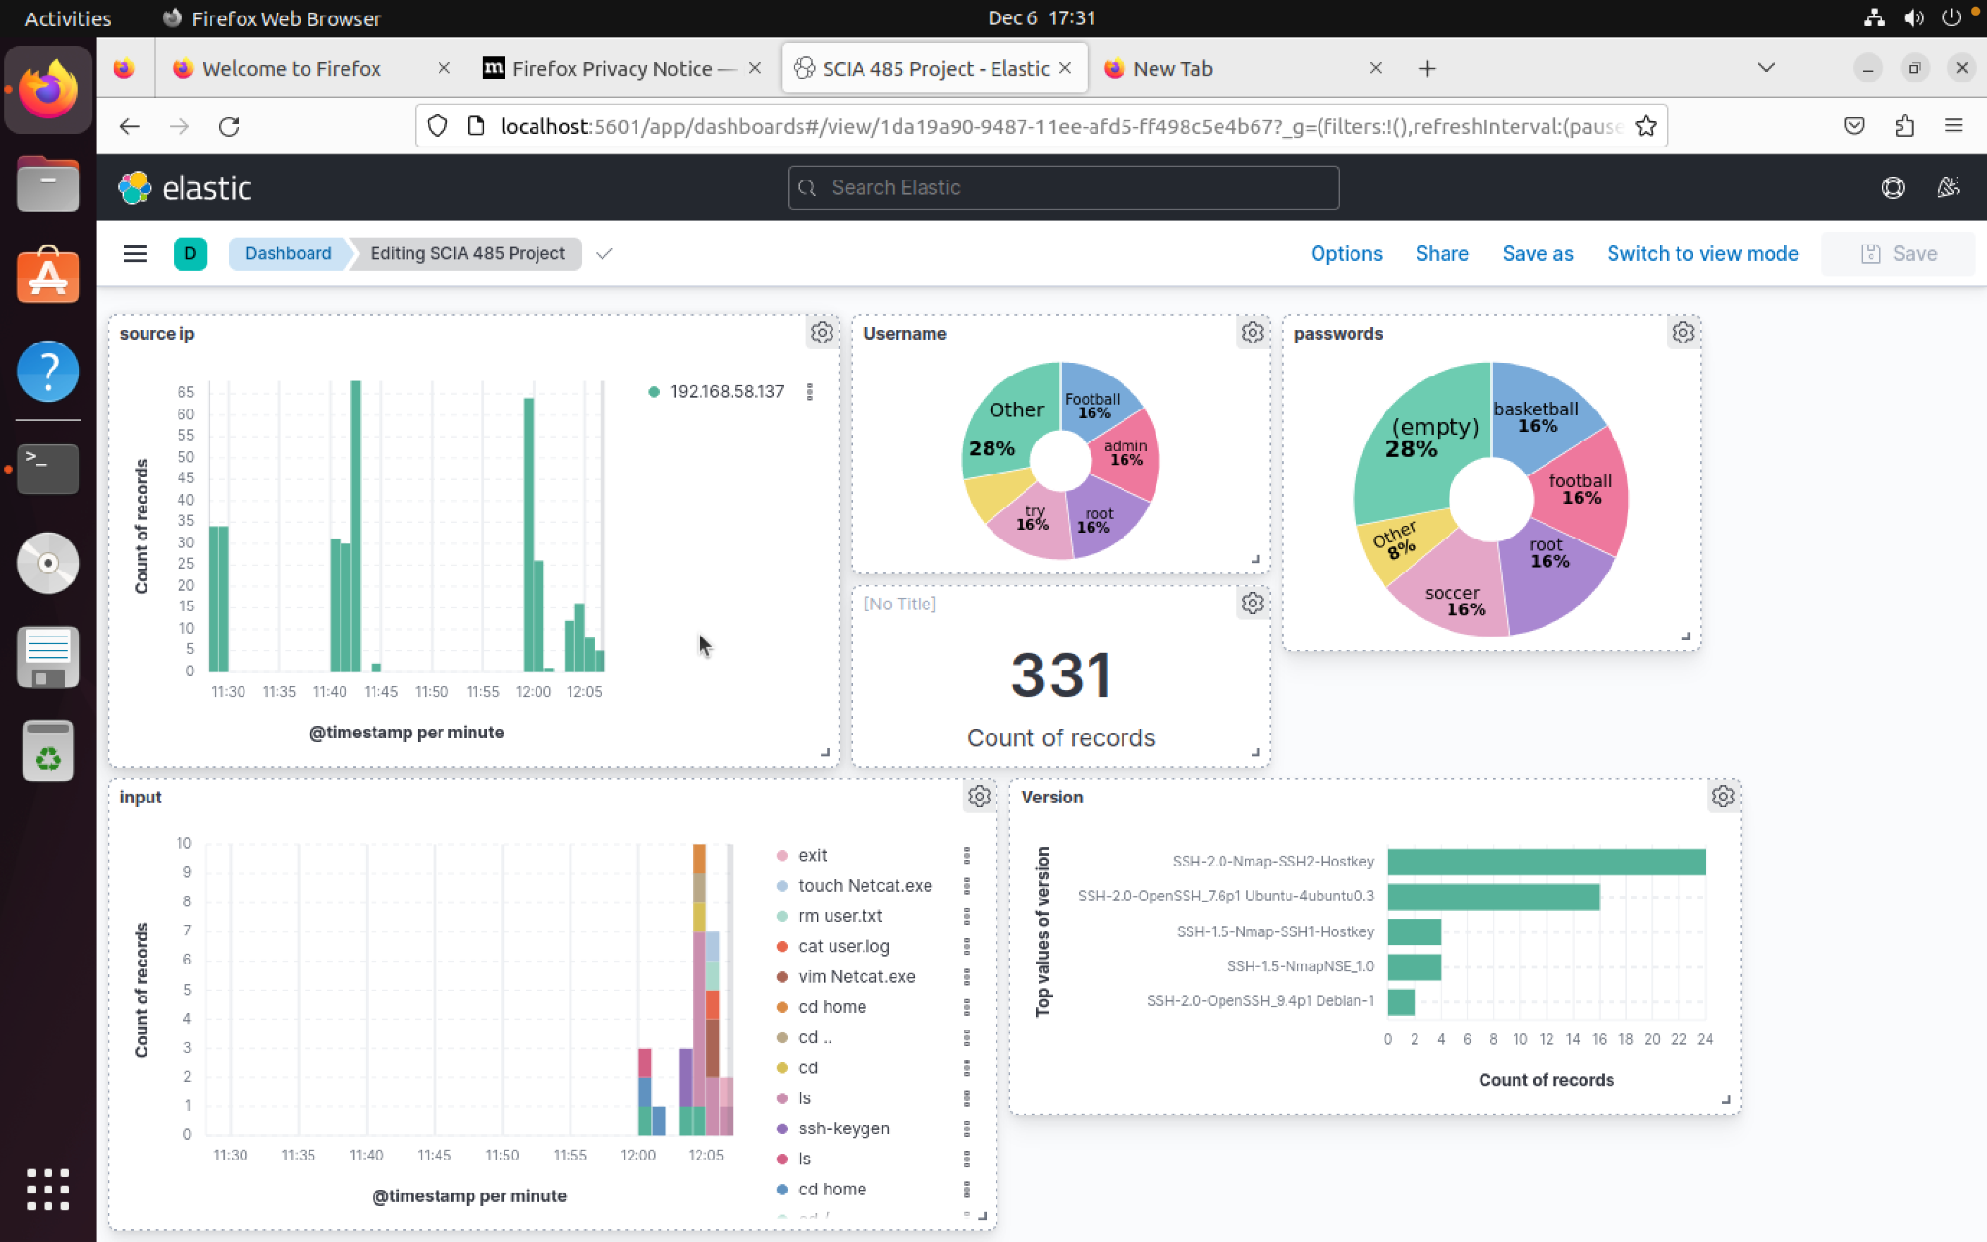
Data Analysis
Used Elastic Stack for Cowrie

Slide 8
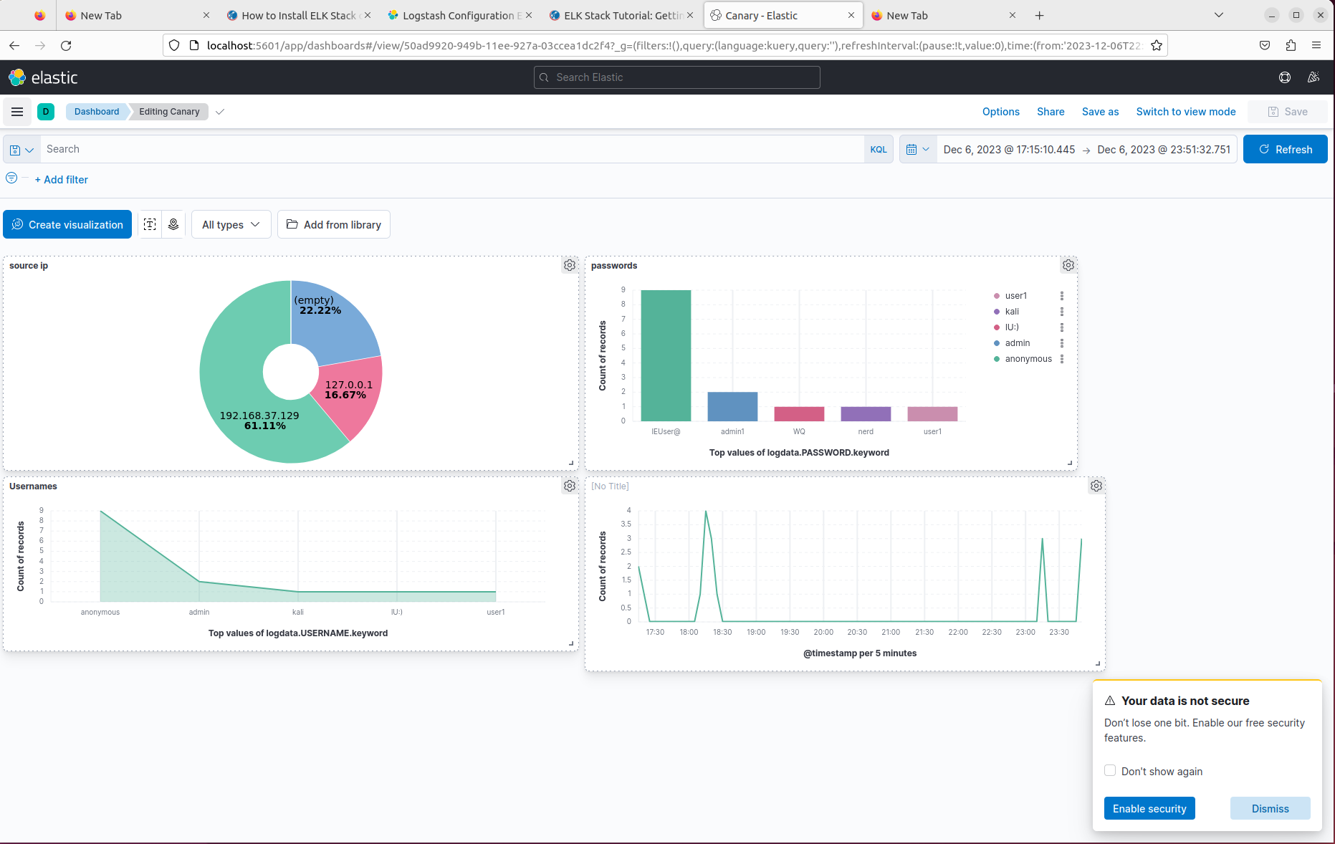
Data Analysis
Used ELK Stack for openCanary

Slide 9
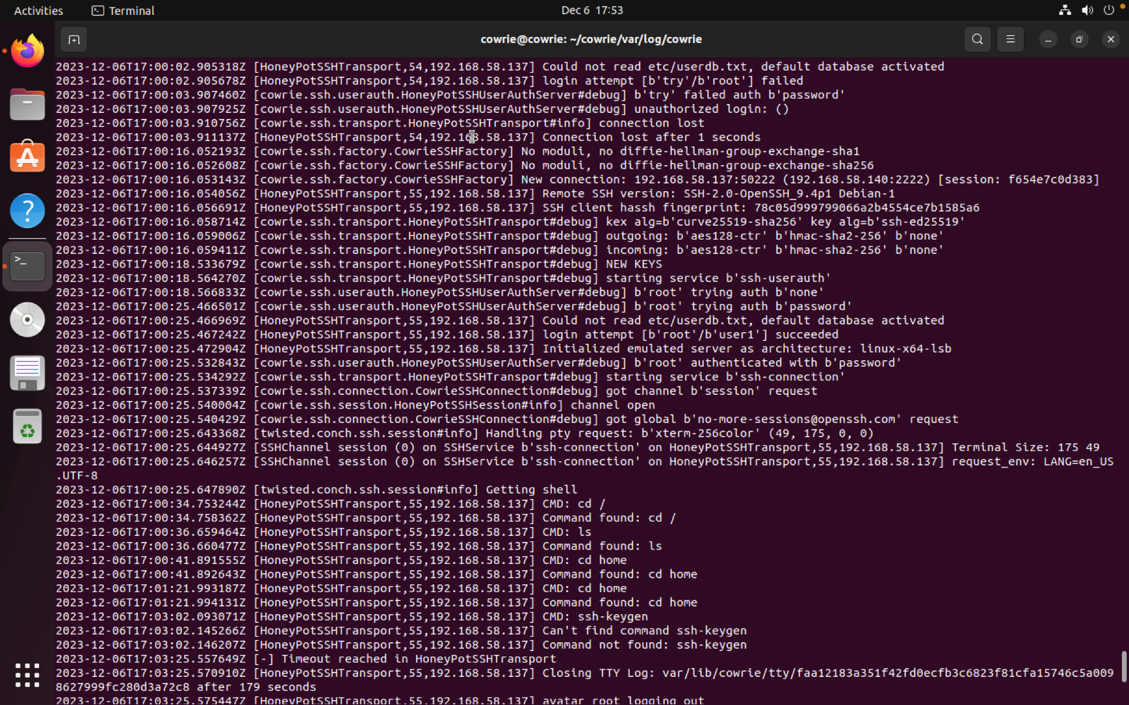
Cowrie Log
Cowrie log for SSH

Slide 10
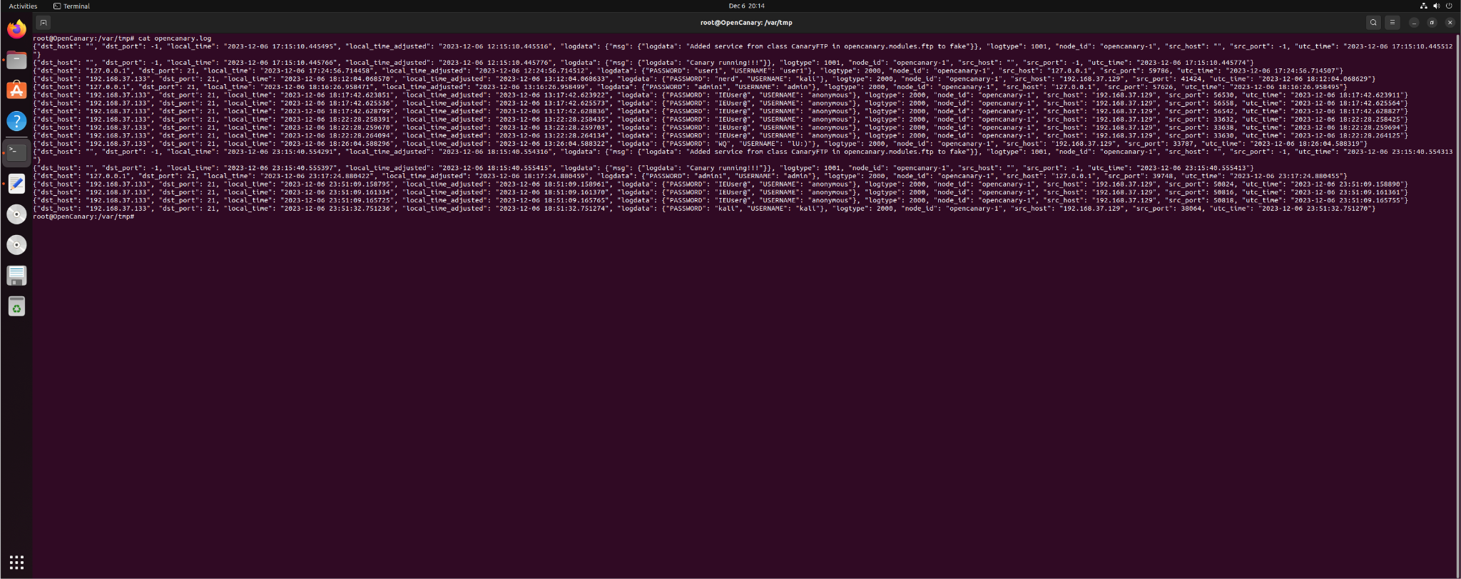
OpenCanary Log

Slide 11
Challenges and Solutions
Challenges
Solutions
Difficulty setting up the Elk Stack
Did not know how to use ELK Stack
Getting the Cowrie JSON file into Kibana
Creating the different visuals
Creating a JSON for OpenCanary
Found up to date youtube videos and website to properly setup ELK Stack.
Interacted with Elk Stack to understand how it works
Asked for help to figure out how to get json onto kibana

Slide 12
Findings/ Recommendations
Key Findings
Recommendations
Cowrie Honeypot logged all information from brute force attacks and command inputs
OpenCanary logged brute force attacks as well as failed login attempts.
Find references that are up to date because the packages change often.
Learn about how to use the honeypots

Slide 13
Conclusion
Project summary: for a quick recap, the purpose of this project is to understand and utilize two different types of honeypots to gather information of unauthorized activity within a network environment.
What we learned:
Honeypots are a valuable tool to have and use in cybersecurity.

Slide 14

Questions?

